Slide 1

Mobile Application Development
Welcome
Class: BS(CS)-VII
Sukkur IBA University – Kandhkot Campus
Week - 07
Lecture – 14
Your Facilitator, Adil Khan

Slide 2
Filing in Android

Slide 3
Files and storage
Android can read/write files from two locations:
– internal and external storage.
– Both are persistent storage; data remains saved after power-off / reboot.
internal storage:
– Built into the device.
– guaranteed to be present
– can't be expanded or removed – specific and private to each app – wiped out when the app is uninstalled

Slide 4
Files and storage
An activity has methods you can call to read/write files:
– getFilesDir() - returns internal directory for your app
– getResources().openRawResource(R.raw.filename) - read an input file from res/raw/ folder
– openFileInput(name, mode) - opens a file for reading
– openFileOutput(name, mode) - opens a file for writing
We use Java I/O classes (java.io.File, java.io.InputStream, OutputStream etc.) to read from/write into the files.

Slide 5
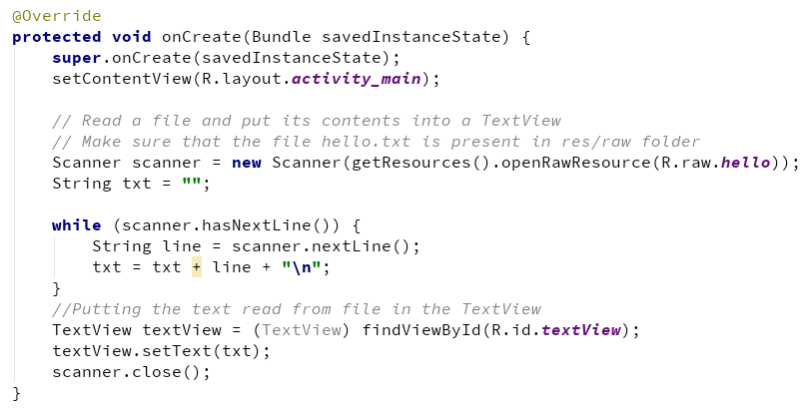
Internal storage example 1

Slide 6
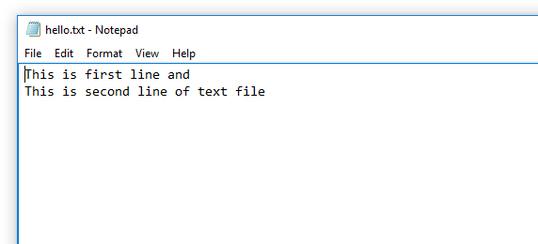
Internal storage example 1

Slide 7
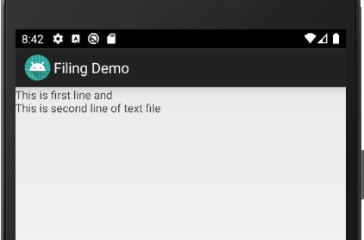
Internal storage example 1

Slide 8
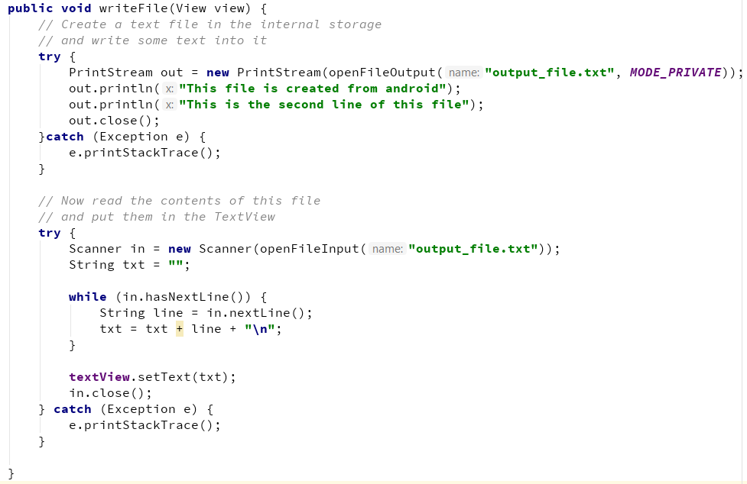
Internal storage example 2

Slide 9
External storage
Card that is inserted into the device. (such as a MicroSD card)
can be much larger than internal storage
can be removed or transferred to another device if needed
may not be present, depending on the device
readable/writable by other apps and users; not private to your app
not wiped when the app is uninstalled, except in some cases

Slide 10
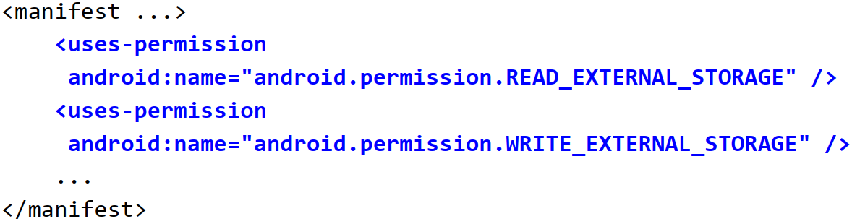
External storage permission
If your app needs to read/write the device's external storage, you must explicitly request permission to do so in your app's AndroidManifest.xml file.
On install, the user will be prompted to confirm your app permissions.

Slide 11
External storage permission
Methods to read/write external storage:
getExternalFilesDir() - returns the path to files folder inside Android/data/data/your_package/ on your SD card. It is used to store any required files for your app (e.g. images downloaded from web or cache files).
Environment.getExternalStoragePublicDirectory(name) - returns public directory for common files like photos, music, etc.
pass constants for name such as Environment.DIRECTORY_ALARMS, DIRECTORY_DCIM, DIRECTORY_DOWNLOADS, DIRECTORY_MOVIES, DIRECTORY_MUSIC, DIRECTORY_NOTIFICATIONS, DIRECTORY_PICTURES, DIRECTORY_PODCASTS, DIRECTORY_RINGTONES

Slide 12
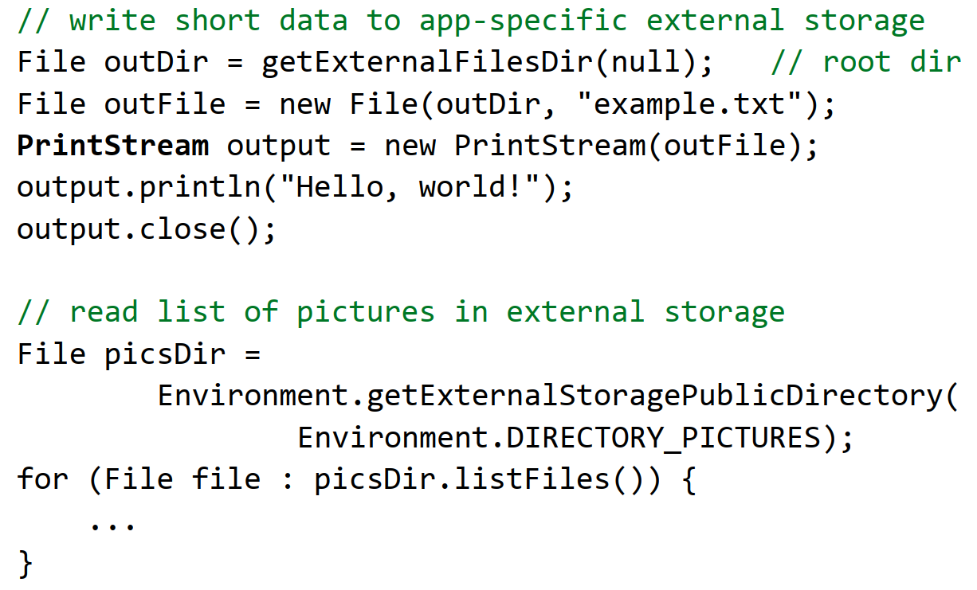
External storage example

Slide 13
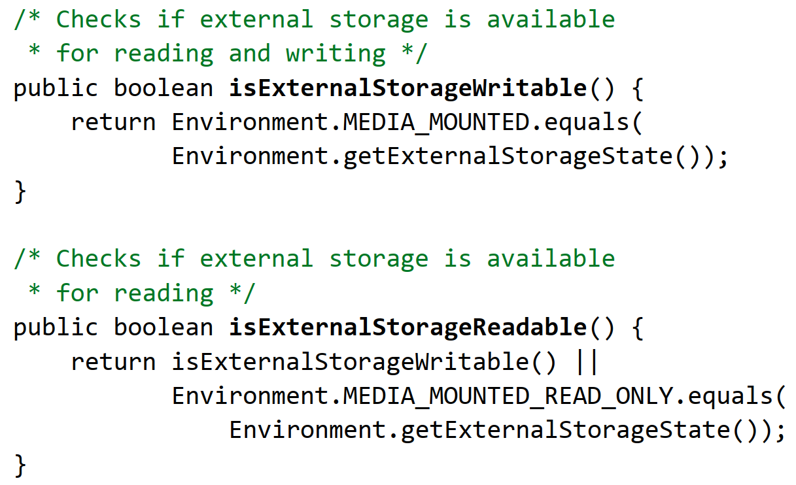
Checking if storage is available

Slide 14
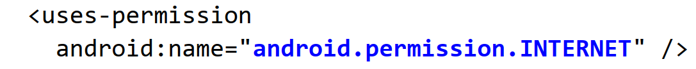
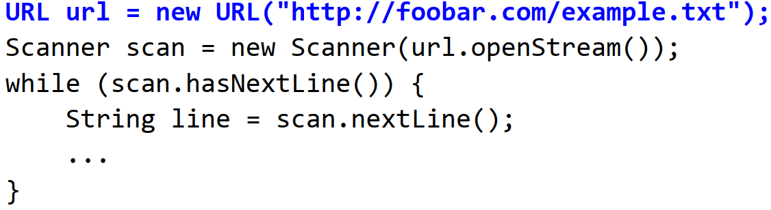
Reading data from web
To read data from the web, first request the INTERNET permission in your AndroidManifest.xml:
Then you can use the standard java.net.URL class to connect to a file or page at a given URL and read its data:

Slide 15
Thank you!
Any Questions???

